Slide 1



A sleep tracking app for a better nights rest

Slide 2

DESCRIPTION
A sleep tracking app is designed to help users understand and improve their sleep quality by monitoring and analyzing sleep patterns
They provide insights into how well a person sleeps each night, offering personalized recommendations for a healthier sleep routine.
The app can analyze different stages of sleep, including
light sleep, deep sleep, and REM (rapid eye movement) sleep. This
breakdown helps users understand the quality of their rest and identify. B
. Patterns that might impact how refreshed they feel upon waking.
Sleep Stage Analysis:

Slide 3
Sleep Duration and Consistency:
The app tracks how long a person
sleeps each night and measures consistency across the week. Consistent
sleep is crucial for health, and seeing trends over time helps users
recognize if they are getting enough rest.
Sleep Score or Quality Rating:
smart alarm feature wakes users up at the optimal time in their sleep cycle, usually during a light sleep phase, so they feel more refreshed and less groggy. The app determines this by analyzing sleep patterns in real-time and choosing the best window to wake the user.
Sleep Recommendations:
Using the data collected, some apps offer tailored recommendations, such as ideal sleep times, suggestions to reduce
. caffeine intake, or bedtime routines that promote relaxation. Some even
include guided meditation, breathing exercises, or soothing sounds to help
. users unwind before bed.

Slide 4


Sleep Environment Monitoring:
Some apps analyze
environmental factors that can affect sleep, such as noise, temperature,
and light levels, using either in-app tools or by syncing with smart home devices.
This can help users create an optimal sleep environment.

Slide 5

SleepTrackingActivity.java
import android.app.AlarmManager;
import android.app.PendingIntent;
import android.content.Intent;
import android.os.Bundle;
import android.view.View;
import android.widget.Button;
import android.widget.TextView;
public class SleepTrackerActivity extends AppCompatActivity {
private Button startSleepButton;
private TextView sleepDurationText;

Slide 6
@Override
protected void onCreate(Bundle savedInstanceState) {
super.onCreate(savedInstanceState);
setContentView(R.layout.activity_sleep_tracker);
startSleepButton = findViewById(R.id.start_sleep_button);
sleepDurationText = findViewById(R.id.sleep_duration_text);
startSleepButton.setOnClickListener(new View.OnClickListener() {
@Override
public void onClick(View v) {
startSleepTracking();
}
});
}

Slide 7
private void startSleepTracking() {
Intent intent = new Intent(this, SleepTrackingService.class);
PendingIntent pendingIntent = PendingIntent.getService(this, 0, intent, 0);
AlarmManager alarmManager = (AlarmManager) getSystemService(ALARM_SERVICE);
alarmManager.setRepeating(AlarmManager.ELAPSED_REALTIME, SystemClock.elapsedRealtime() + 60000, 60000, pendingIntent);
}
}

Slide 8
AndroidMainFest.xml file
<?xml version="1.0" encoding="utf-8"?>
<manifest xmlns:android="http://schemas.android.com/apk/res/android"
package="com.example.android.trackmysleepquality">
<application
android:allowBackup="true"
android:icon="@mipmap/ic_launcher_sleep_tracker"
android:label="@string/app_name"
android:roundIcon="@mipmap/ic_launcher_sleep_tracker_round"
android:supportsRtl="true"
android:theme="@style/AppTheme">
<activity android:name=".MainActivity"

Slide 9
android:configChanges="orientation|screenSize|screenLayout
|keyboardHidden" android:exported="true">
<intent-filter>
<action android:name="android.intent.action.MAIN" />
<category android:name="android.intent.category.LAUNCHER" />
</intent-filter>
</activity>
<meta-data
android:name="preloaded_fonts"
android:resource="@arr poiay/preloaded_fonts" />
</application>
. </manifest>

Slide 10
build.gradle (Project-level)
buildscript {
ext {
version_core = "1.13.1"
version_coroutine = "1.8.1"
version_constraint_layout = "2.1.4"
version_gradle = '8.7.2'
version_kotlin = '1.9.23'
// version_lifecycle_extensions = "2.2.0"
version_lifecycle = '2.8.2'
version_navigation = '2.7.7'
Version_room = '2.6.1'
}

Slide 11
repositories {
mavenCentral()
google()
}
dependencies {
classpath "com.android.tools.build:gradle:$version_gradle"
classpath "org.jetbrains.kotlin:kotlin-gradle-plugin:$version_kotlin"
classpath "androidx.navigation:navigation-safe-args-gradle-plugin:$version_navigation"
// NOTE: Do not place your application dependencies here; they belong
// in the individual module build.gradle files
}
}

Slide 12
allprojects {
repositories {
mavenCentral()
google()
}
}
task clean(type: Delete) {
delete rootProject.buildDir
}

Slide 13
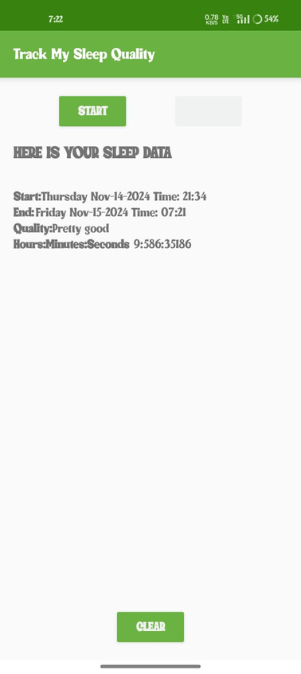
Output

Slide 14
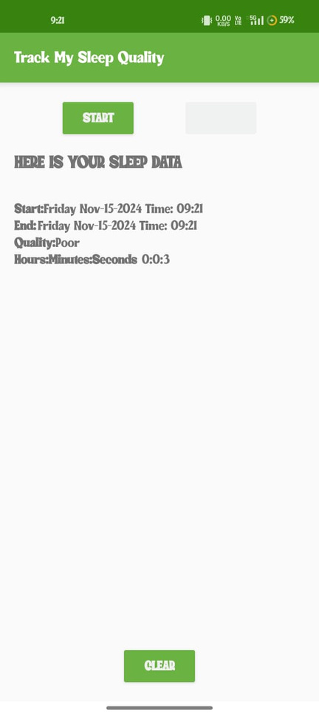

Slide 15
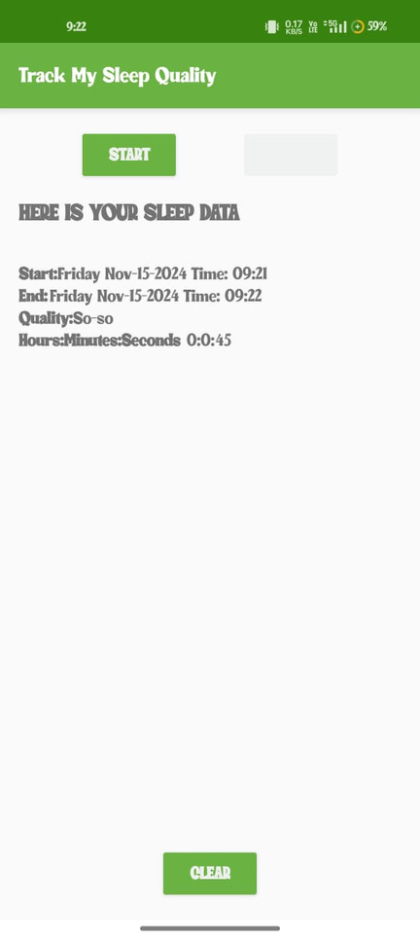

Slide 16
